Slide 1

Aiming for the Right Price in Ames
Christopher Williams
DSI Project 2
December 7, 2018

Slide 2
Data Science Problem
Create a regression model based on the Ames, Iowa Housing Dataset to predict the price of a house at sale from 2006 to 2010

Slide 3
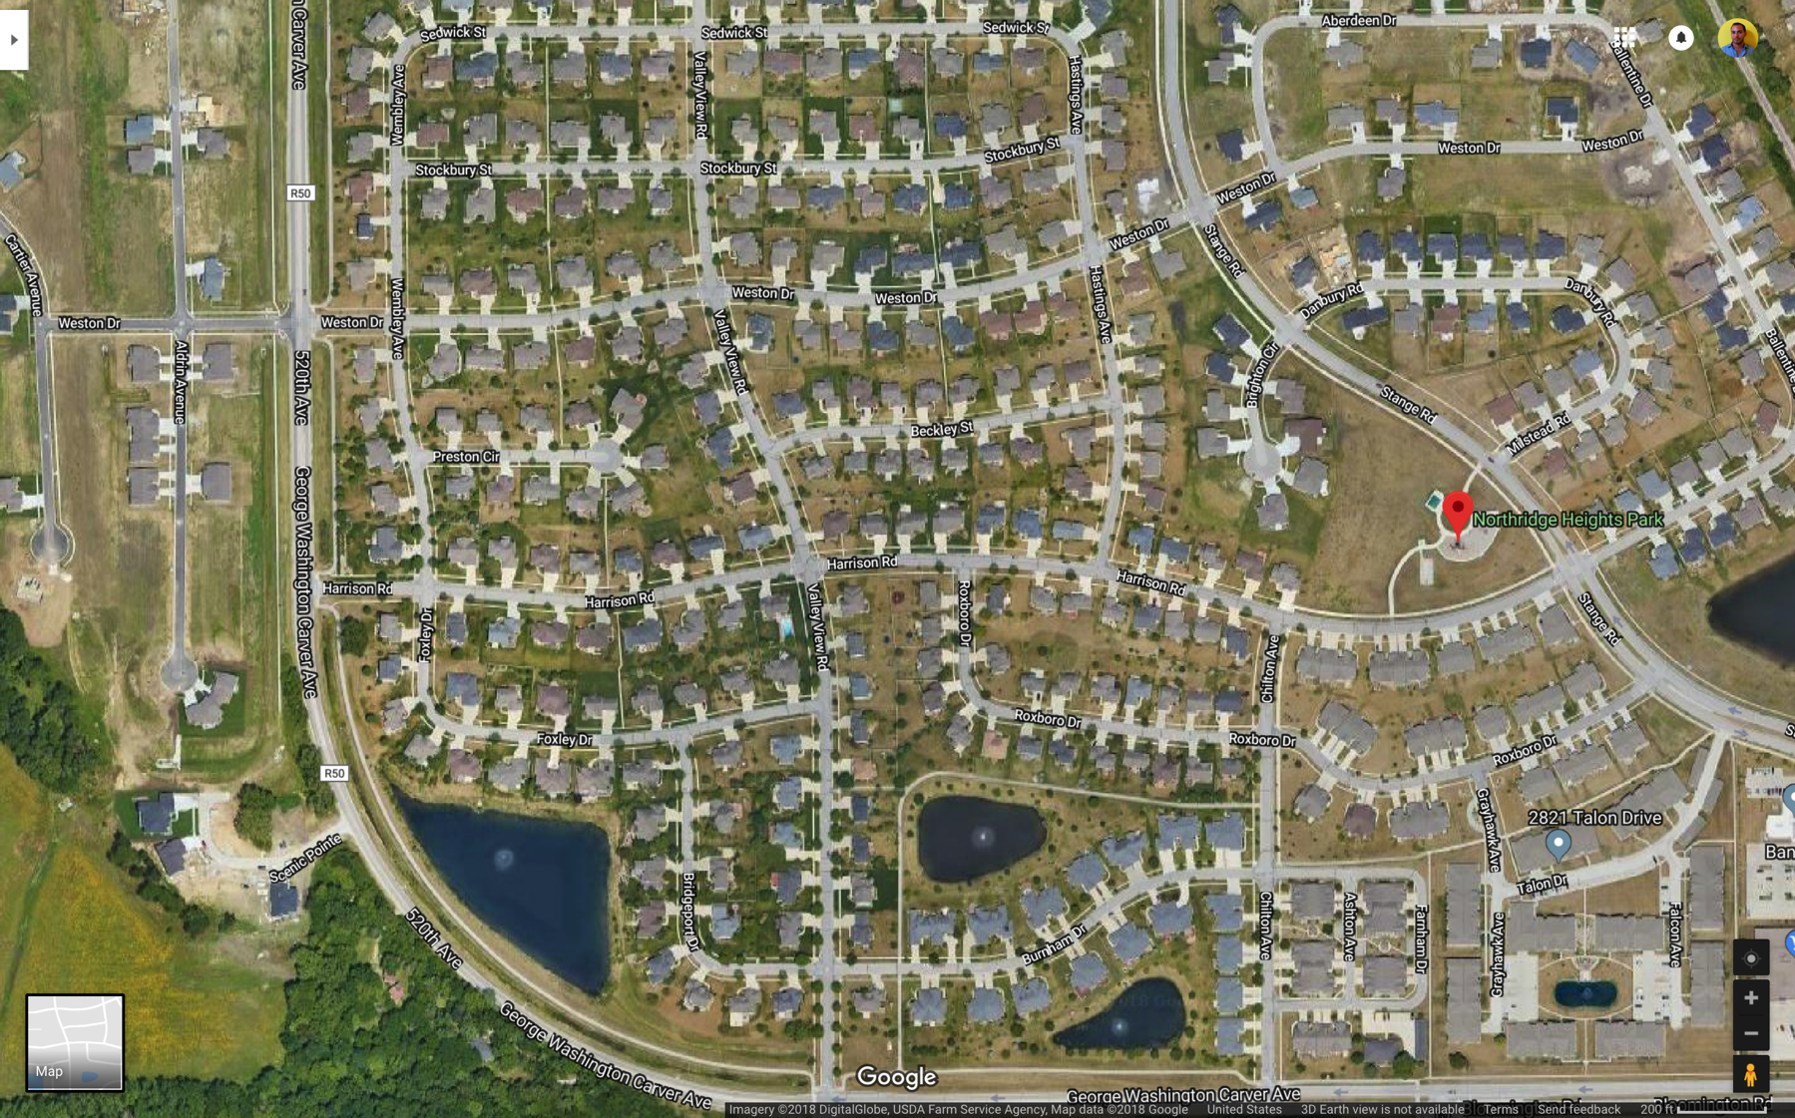
Ames, Iowa

Slide 4
About Ames, Iowa
Census of 2010
58,965 people
22,759 households
9,959 families
999,789,198 cats
23,876 housing units

Slide 5
The Data
We were provided with two data files
Train dataset with SalePrice data
2051 rows of houses
81 rows columns
Test dataset without SalePrice data
879 rows of houses
80 rows columns
What to do with the Data?
Clean up
Map out categorical & qualitative values to quantitative
Leave outliers out

Slide 6
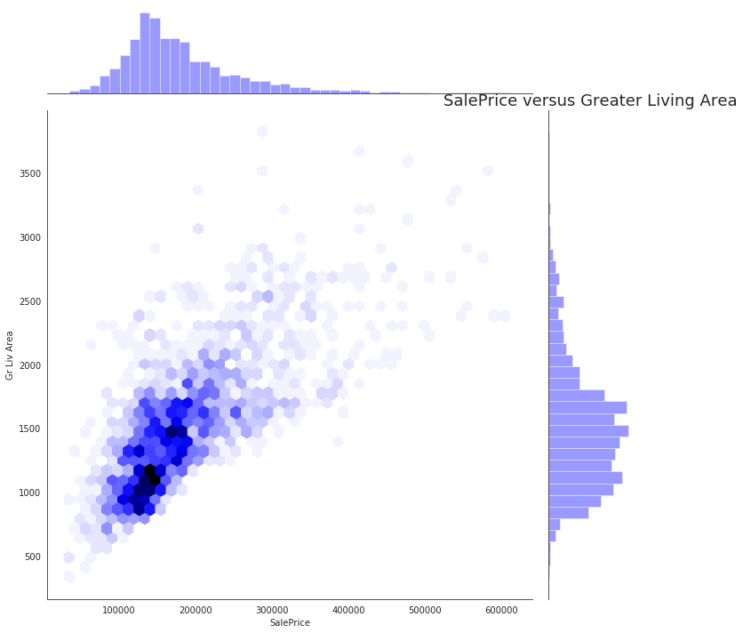
EDA

Slide 7
Dealing with the Data
What changes and assumptions to make on data in model?
Take out four outliers (see slide)
Map Values for qualitative and categorical features (see slide)
Example mapping qualities to a numerical scale:
{“Ex”:7, “Gd”:4, “TA”:3, “Fa”:2, “Po”:1}
Ex = excellent, Gd = good, TA = average, Fa = fair, Po = poor
Perform Log Transformation of SalesPrice to make normally distrubted (see slide)

Slide 8
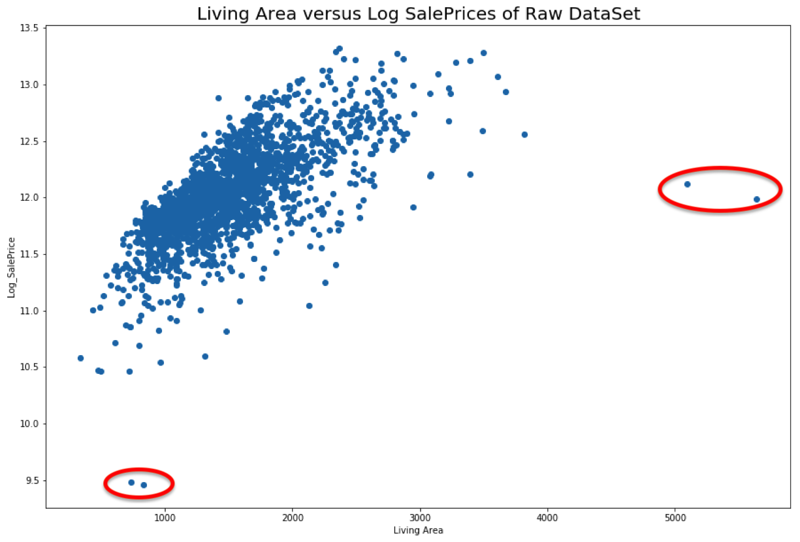
Data Cleanup Before removing 4 outliers

Slide 9
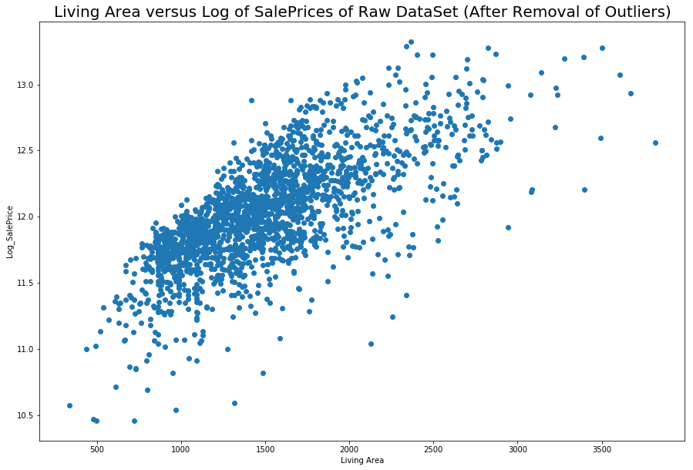
Data Cleanup After removing 4 outliers

Slide 10
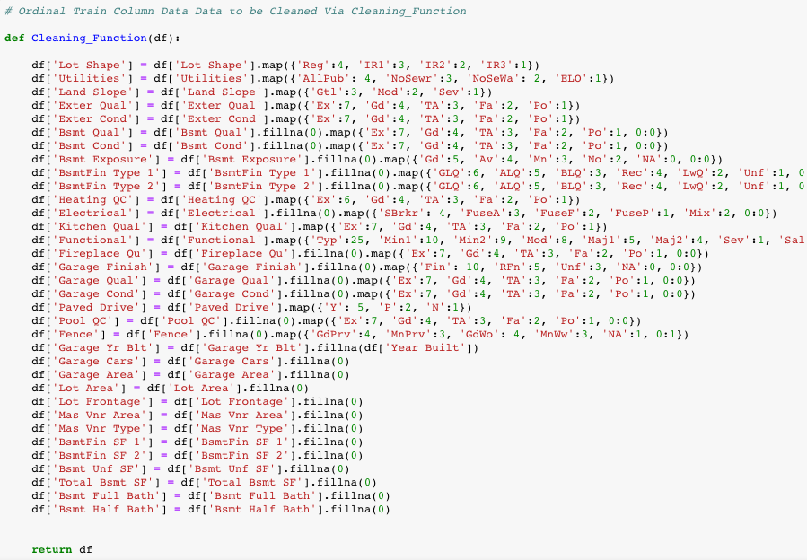
Data Mapping & Cleaning

Slide 11
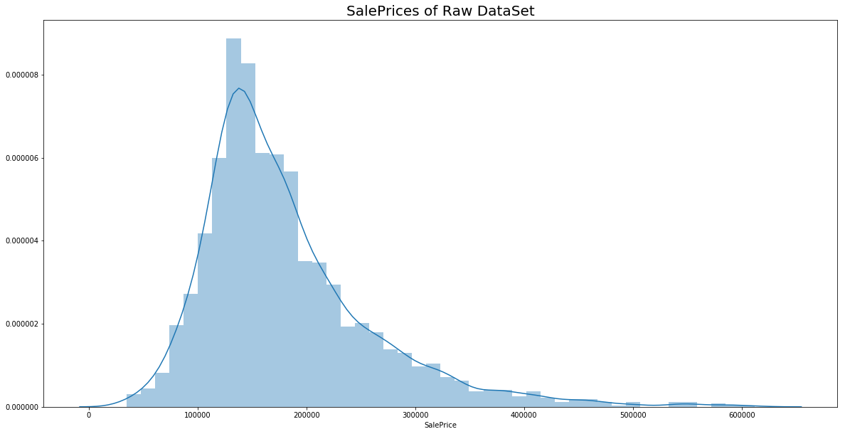
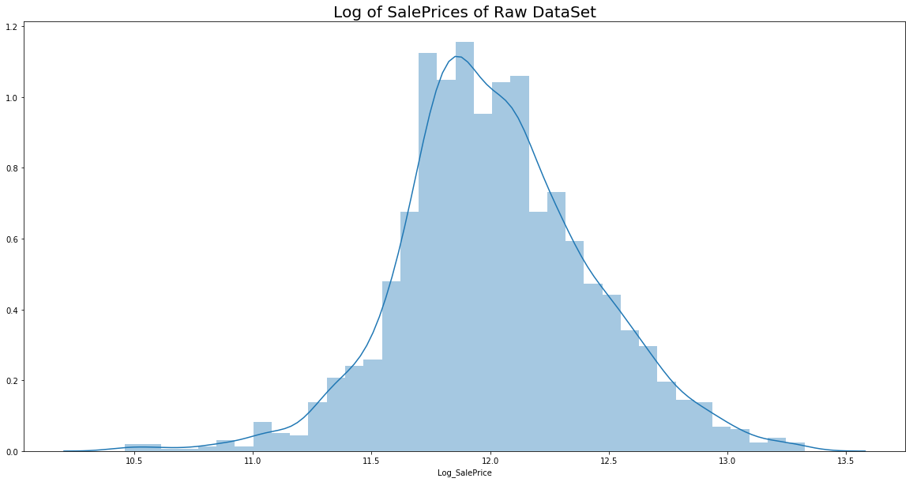
Sale Prices log transformation of SalesPrice

Slide 12
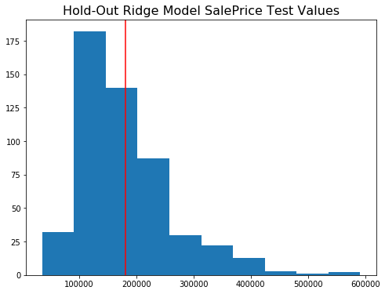
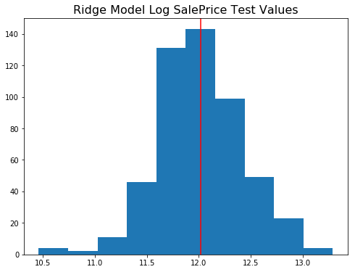
Visualization of SalePrice

Slide 13
Regression Model
Lasso vs. Ridge
Model using Lasso vs. Ridge regression regularization to account for feature coefficients’ impact on predictions
Feature Selection
Used features both positively and negatively correlated with SalePrice
How to score and judge the models?
Models are predicting the target of SalePrice
Models are being scored by Kaggle on 30% of the test data before our presentation on Friday December 7th. I’ll optimize for this for a methodical approach
Final models will be scored by Kaggle’s remaining 70% of test data on Saturday December 8th. Which will reveal correct or incorrect assumptions and areas of improvement.

Slide 14
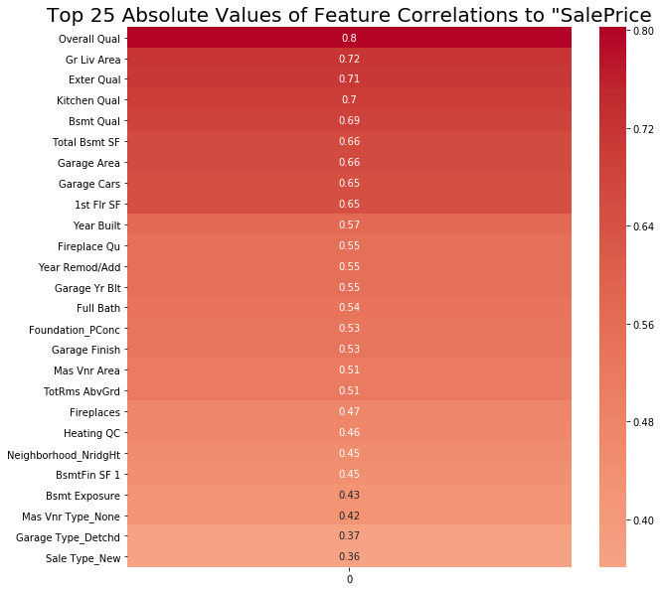
Correlation as First Factor of Feature Selection

Slide 15
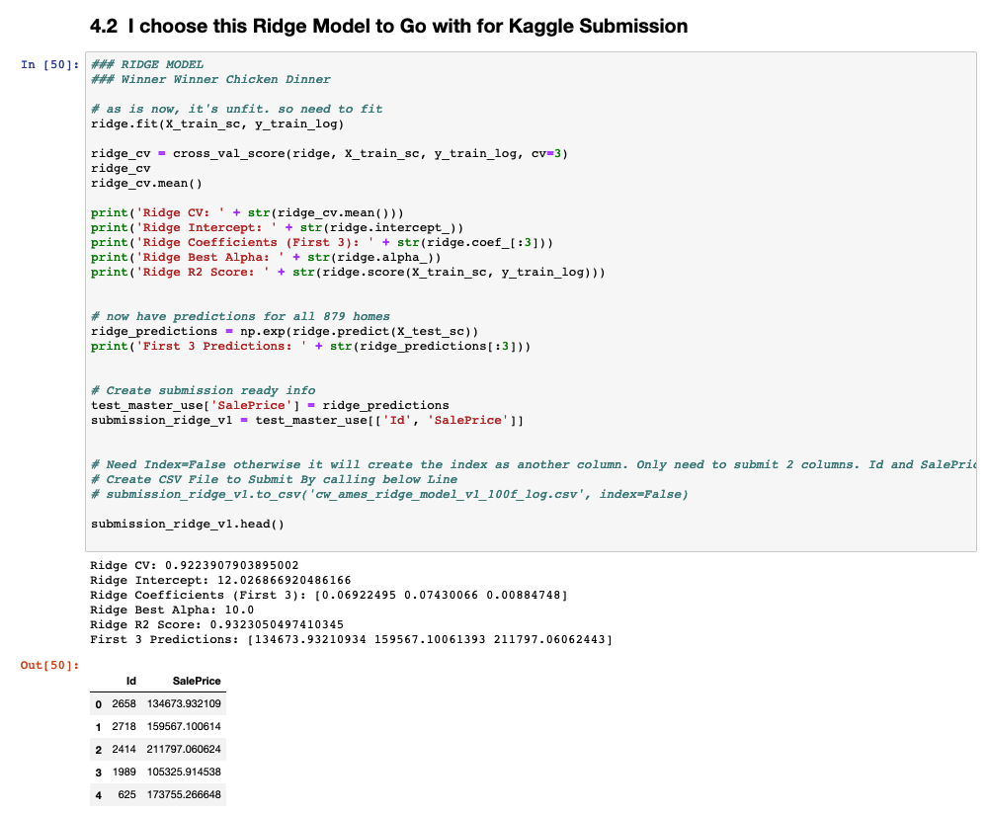

Slide 16
Evaluating my models
Evaluation metrics
MSE – mean squared error of predicted housing price and actual housing price in hold out dataset
“In statistics, the mean squared error (MSE) or mean squared deviation (MSD) of an estimator (of a procedure for estimating an unobserved quantity) measures the average of the squares of the errors—that is, the average squared difference between the estimated values and what is estimated.” Wikipedia
Baseline score
Ridge R2 Baseline Score: 0.748
'Overall Qual', 'Gr Liv Area’ are the biggest correlating features
How will my model will generalize to new data?
This will be determined by using it on the full holdout test dataset.

Slide 17
Results
Ridge – Winner Winner Chicken Dinner
99 features, cv=3, ss, log and exp
R^2 of 0.932
Alpha of 10
Intercept at 12.02
CV of 0.922
Lasso
R^2 of 0.931
Alpha of 0.00058
Intercept at 12.02
CV of 0.921
Hold-Out model versus final submission MSE difference of 7%
MSE of 20,142 Kaggle versus MSE 21,647of Ridge Hold-Out

Slide 18
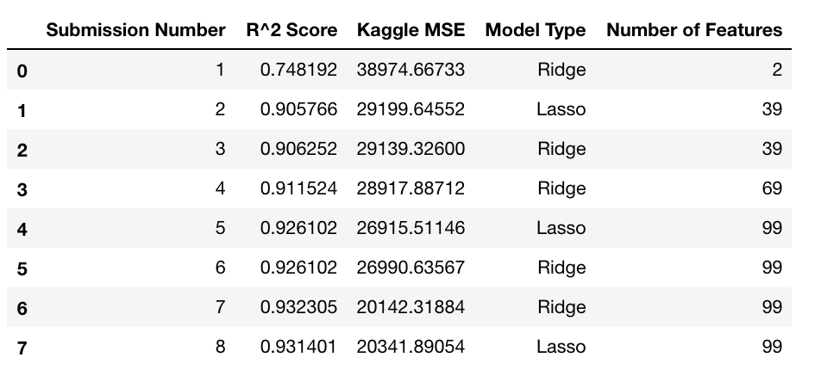
R^2 and Kaggle Scores

Slide 19
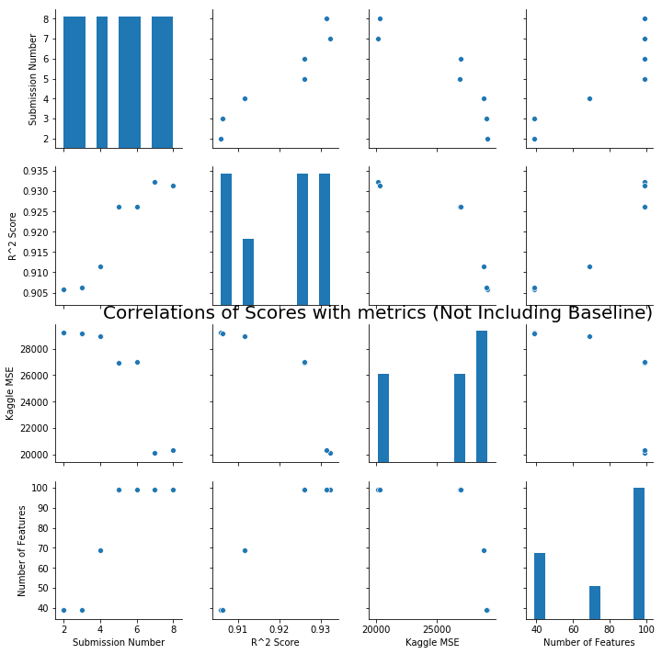

Slide 20
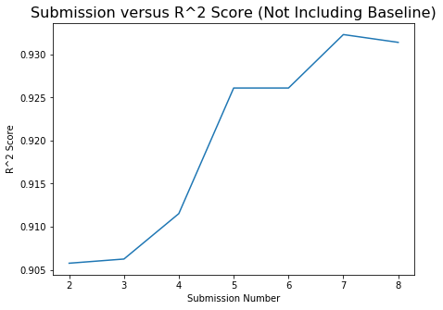
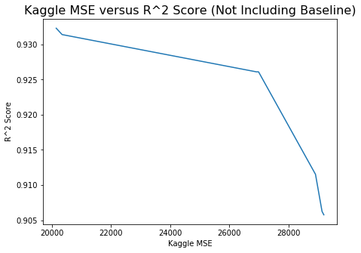
R^2 and Kaggle Scores

Slide 21
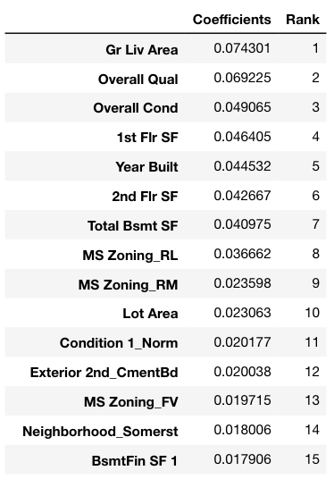
Coefficients

Slide 22
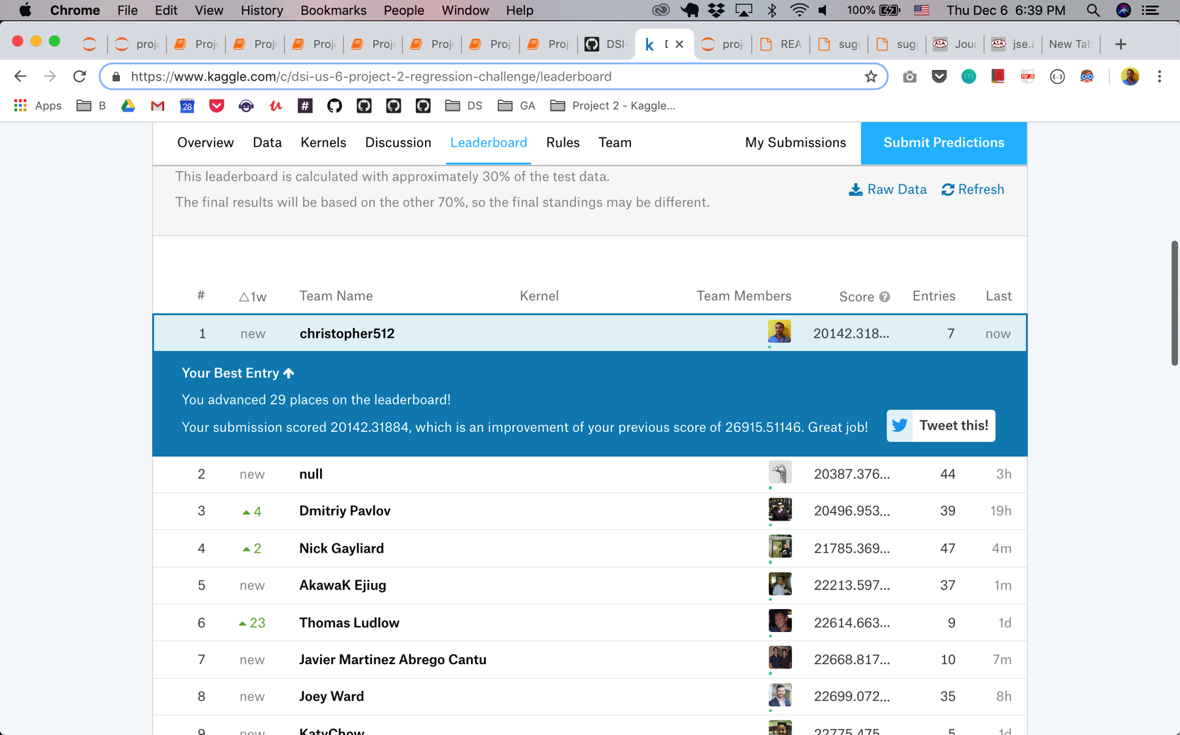
Scoring… on 30% test data Optimized to get first place.

Slide 23
Model Performance
For my models and the assumptions I made with the data, such as the cleaning and mapping process and leaving out the outliers, the Ridge model performed slightly better than Lasso with more features while Lasso model performed better with less features on the 30% of test scoring.
Since the presentation was on Friday Dec 7th and we could only see Kaggle’s scoring of our model on 30% of the data at that time, I optimized for that. Which I was able to in 7 attempts get to the 1st position on the leader board with a MSE of 20,142.
The following day, on Saturday Dec 8th, the 70% of the final Kaggle Data scored our models and my models performance dropped substantially to a MSE of 37, 365. I learned that the models that performed best were the ones that left in the four outliers that I had dropped. That shows the importance of allowing the models to learn the data and make predictions with the full dataset.

Slide 24
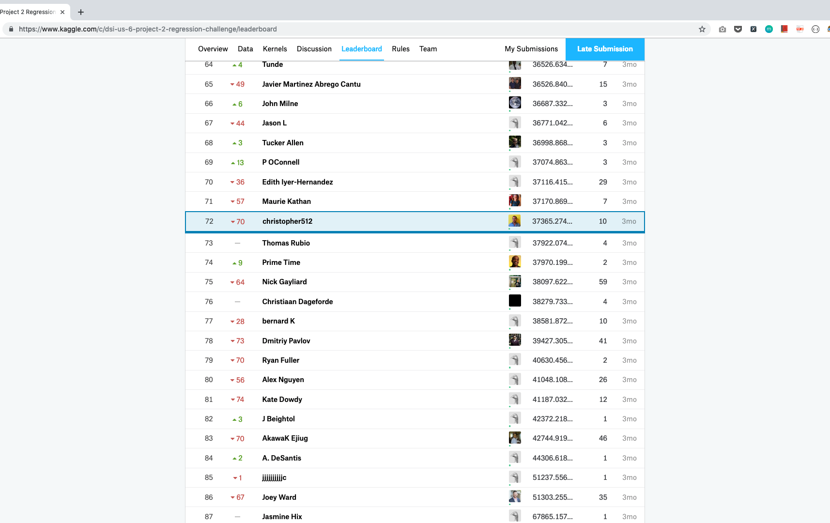
Scoring… on final 70%, large drop due to dropping outliers

Slide 25
Conclusions & Takeaway
In conclusion, if I were to do the project over with the goal to minimize mean squared error for the final 70%, it would have been best to have left in the four outliers I had taken out. In terms of how my assumptions would have helped our hindered the predictions, that is hard to infer. Let the model perform and predict to see.
My key takeaway is that it is easiest to improve the model performance very significantly in the beginning, but that making additional changes and improving it from an already good model to a great model is difficult and is a decision to be made in light of your objectives, time, and data resource constraints.

